Slide 1


Smart Skills
Week 6
Map 2: Geographic Regions of West Virginia
Notes:
See the Smart Skills directions on the Teacher Tech Website for West Virginia: Our Beautiful Home for teaching suggestions.
Teacher notes and answers will display in this space.

Slide 2

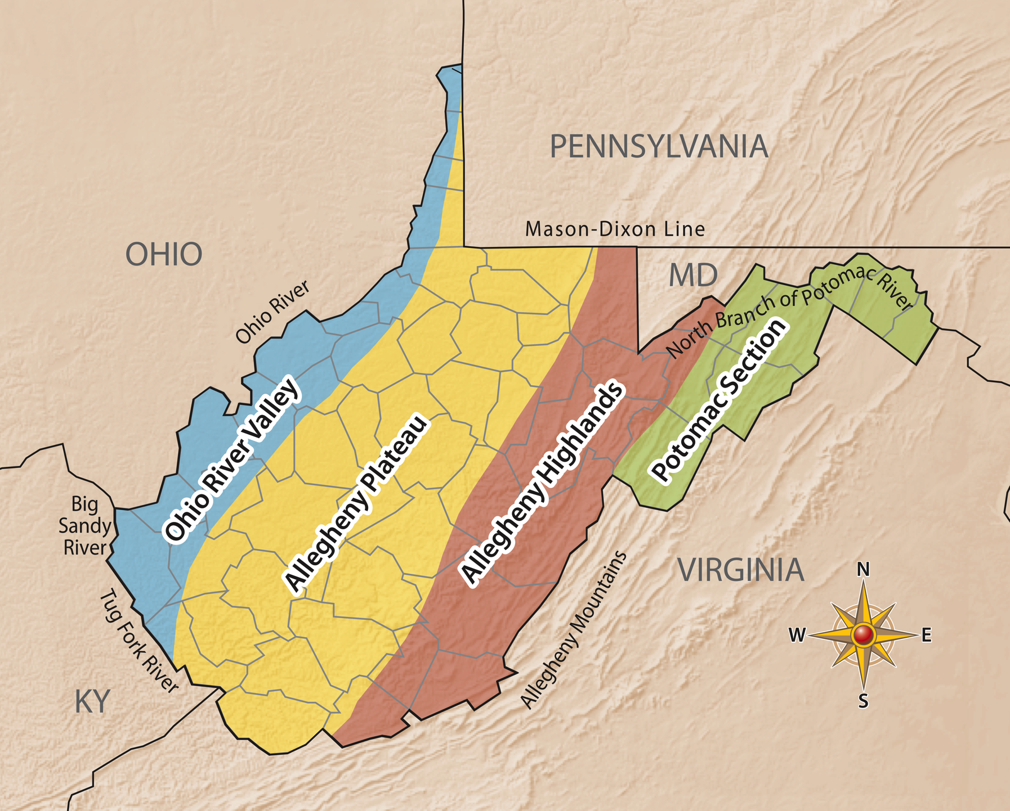
Monday
Study the map. What do you notice about it? In the time given by your teacher, jot down the things that you notice about the map.
Notes:
This opener allows students to view the map with no specific question to answer. Often, it is beneficial to study a map and its components before searching for a specific answer.
Allow at least one minute for students to silently study the map and create a jot list before discussing responses as a group.
Students may notice that this is a map of West Virginia. There is a compass rose. The map only has several colors identifying various areas of the state. Border states are shown, etc.

Slide 3
TUESDAY
How many geographic regions are shown?
How are the geographic regions identified on the map?
Notes:
four
Different colors are used to show the regions.
This may be a good opportunity to assess students' knowledge of West Virginia’s regions. You may want to have a brief discussion of the characteristics that make each region distinct.

Slide 4
WEDNESDAY
What region has the largest area?
What region has the smallest area?
In which region(s) do you live?
Notes:
Allegheny Plateau
Potomac Section
Answers will vary according to your location.
This is a good opportunity to discuss that some counties are in two regions. Why might that be the case?

Slide 5
THURSDAY
What states border West Virginia?
What physical features are labeled on the map?
What man-made demarcation line is identified on the map? What state does the line separate from West Virginia?
Notes:
Ohio, Pennsylvania, Maryland, Virginia, Kentucky
Ohio River, North Branch of Potomac River, Allegheny Mountains, Tug Fork River, Big Sandy River
Mason-Dixon line
Pennsylvania
Use this opportunity to discuss how the borders can be natural features like a river, or man-made like the surveyor’s Mason-Dixon line.

Slide 6
FRIDAY
A student claims that the Ohio River Valley is found only in West Virginia, as shown by the map. What evidence could be used to support or dispute the student’s claim?
Notes:
Students could use other maps to locate the Ohio River Valley to see if it extends into other states. Students can also use authoritative sources, such as encyclopedias or government websites, to find information.
For discussion, ask some of the following questions:
We know that the Ohio River Valley extends to other states, but why wasn’t this shown on the map?
Why didn’t the person creating the map show that the geographic regions extend beyond the borders of West Virginia?
This is an opportunity to explicitly teach that maps are created for a purpose, and in this case, the purpose is focused on the regions of West Virginia. By extending the color bands to the neighboring states, the map might have lost its focus.

Slide 7

Image credits: Title slide, West Virginia State Capitol, Charleston, WV, ©Shutterstock; End slide, Williams River Valley Overlook, Black Mountain, Monongahela National Forest, West Virginia, ©Shutterstock.

