Slide 1
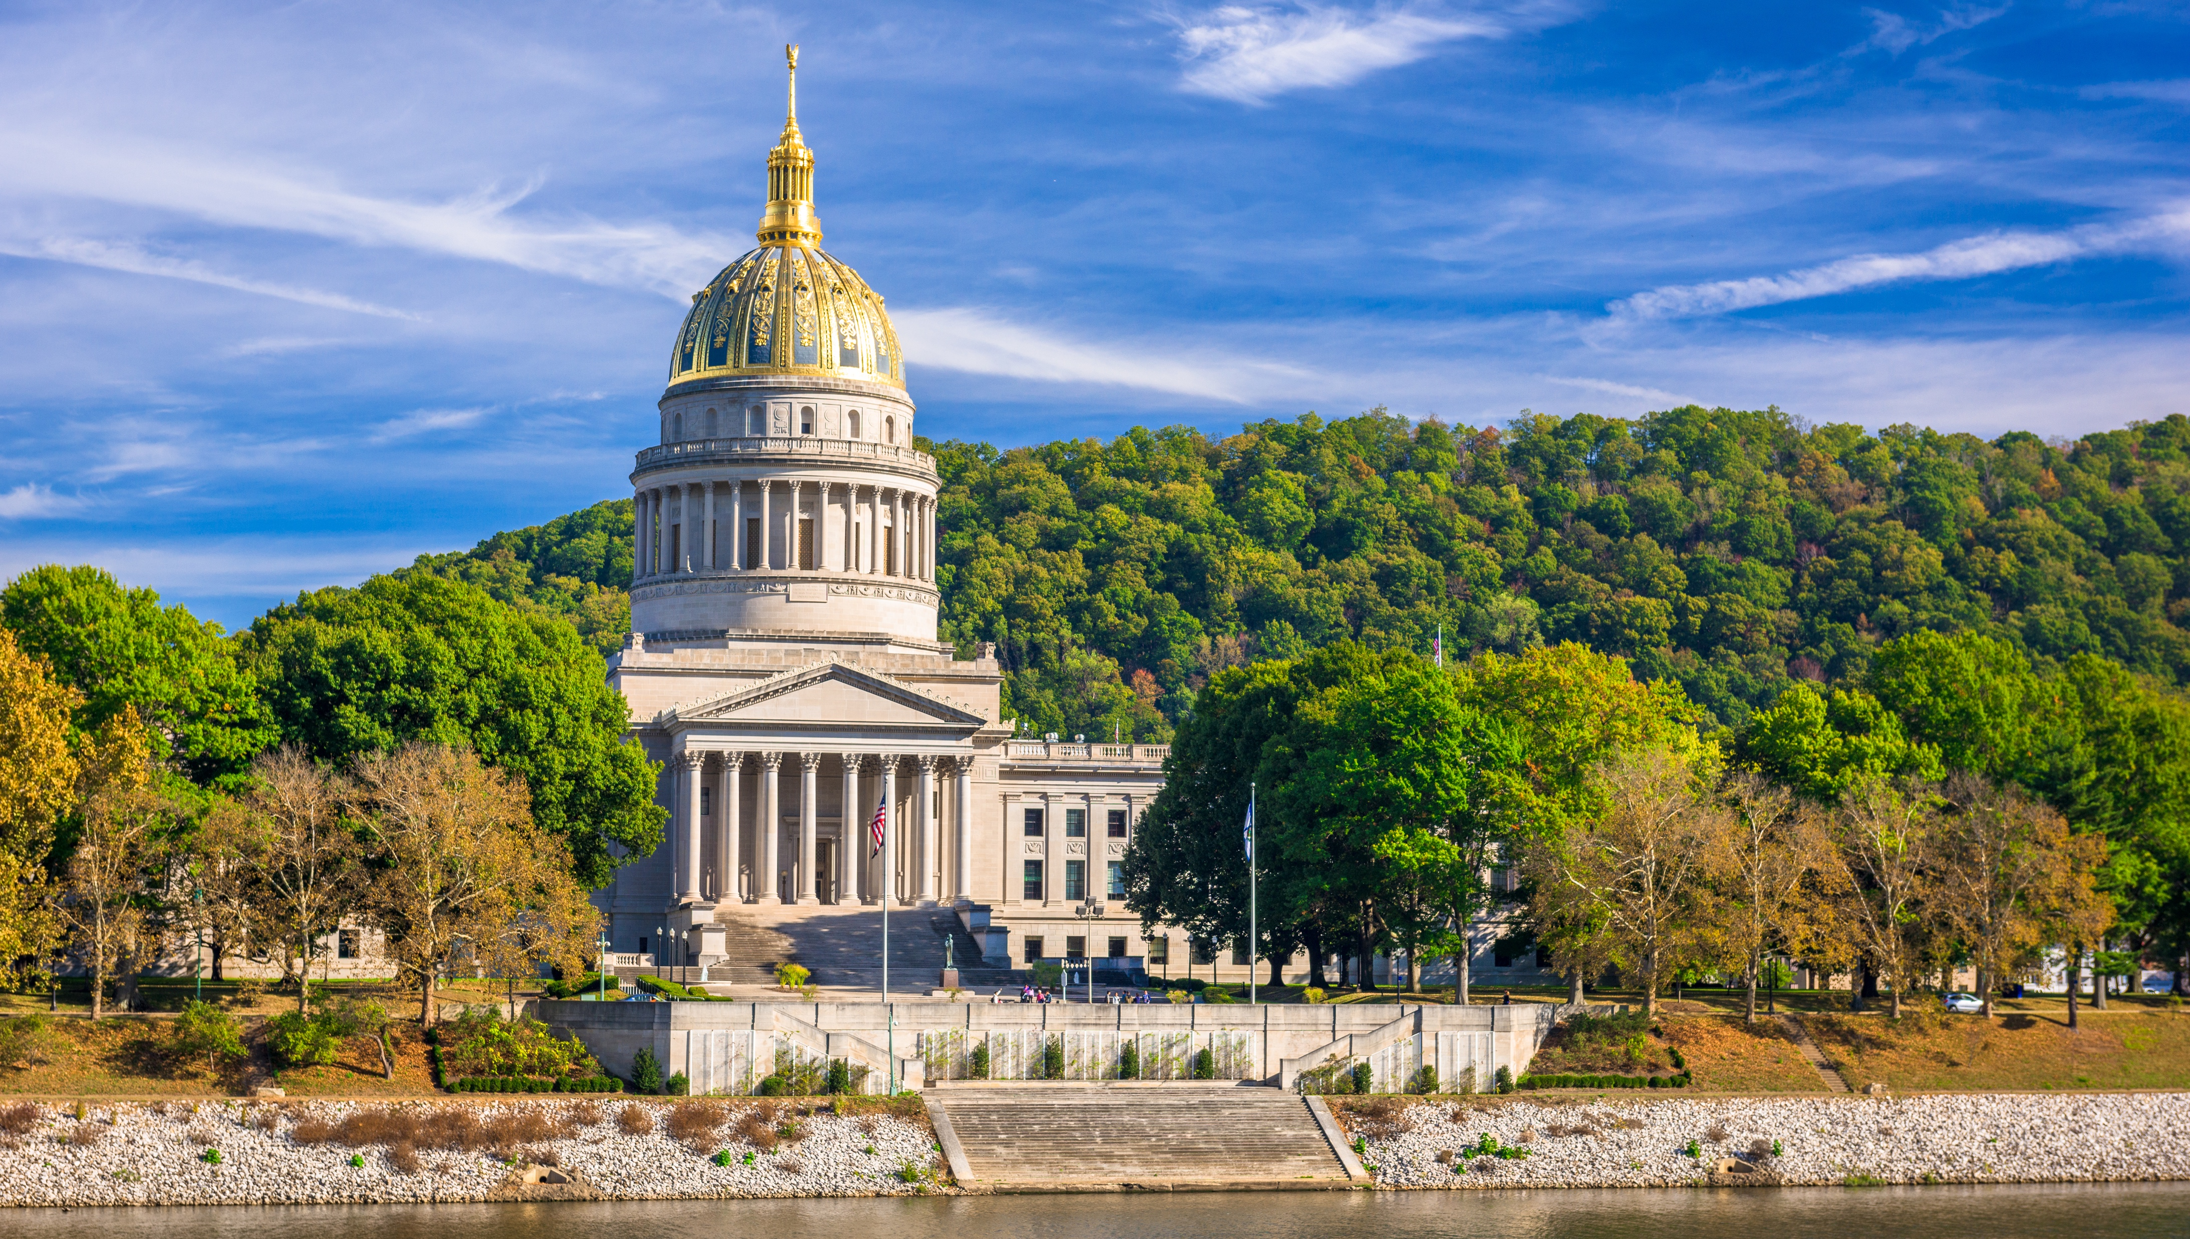

Smart Skills
Week 8
Art & Artifacts 2: Colonial Artifact
Notes:
See the Smart Skills directions on the Teacher Tech Website for West Virginia: Our Beautiful Home for teaching suggestions.
Teacher notes and answers will display in this space.

Slide 2

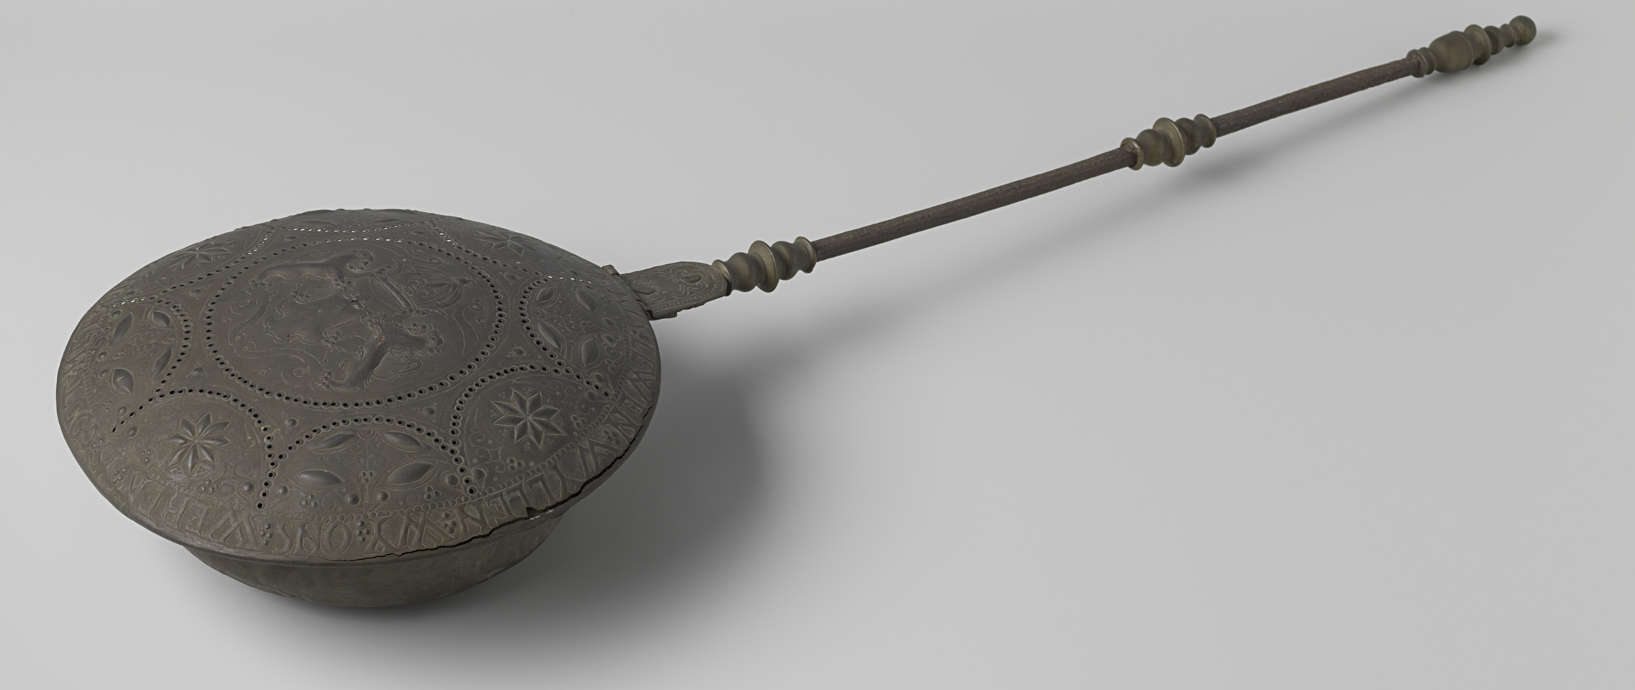
Monday
Study the artifact. Make a list of as many observations of the artifact as you can.
Notes:
Answers will vary. Examples include: made of metal, dark, has a bowl and handle, holes in the top, letters and designs, etc.
Allow students a brief time to record observations, such as 1-2 minutes.
Guide the follow-up class discussion to include observations only.

Slide 3
TUESDAY
What might be the purpose of the artifact? Explain your thinking.
Notes:
Answers will vary.
Students may respond that they need additional information about the artifact, such as its size and where it was found.

Slide 4
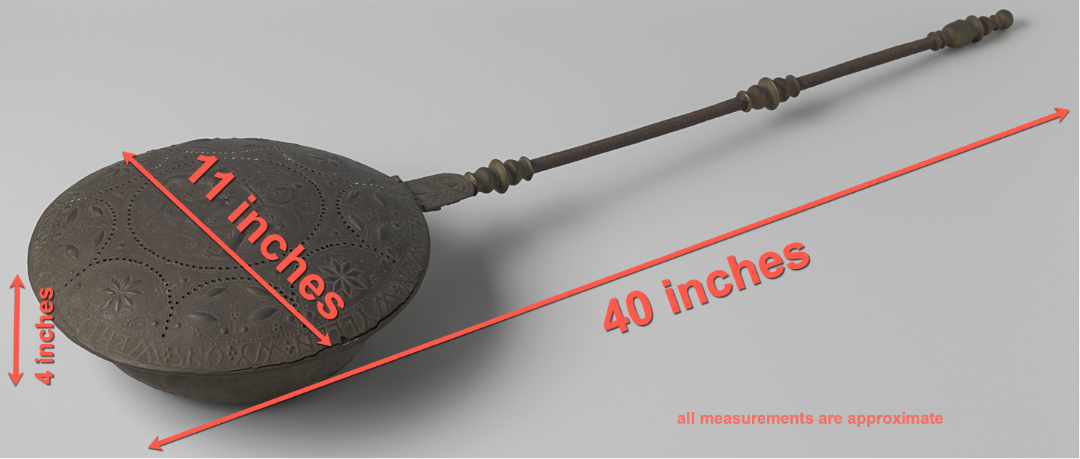
WEDNESDAY
What has been added to the image?
How does this information help you understand the artifact?
Notes:
Approximate measurements have been added. These help explain the size of the object, for example, it’s not something that would likely be used as a kitchen utensil.

Slide 5

THURSDAY
This object was made in the mid-1600s. How does knowing the date help you consider why it was made?
Notes:
Answers will vary.
This was a manufactured good, and the quality of workmanship suggests that it would have been in the home of a wealthier member of the community.

Slide 6
FRIDAY
The artifact was called a warming pan or bed warmer. Why do you think such an item was made? Where and when would it have been used?
Notes:
Answers will vary. You can supply information at the end of the class discussion, if needed, to explain that warming pans were filled with hot embers from a fireplace and then moved back and forth under bed linens to warm the bed on cold nights.
Guide students to consider when such an item would no longer be needed.

Slide 7
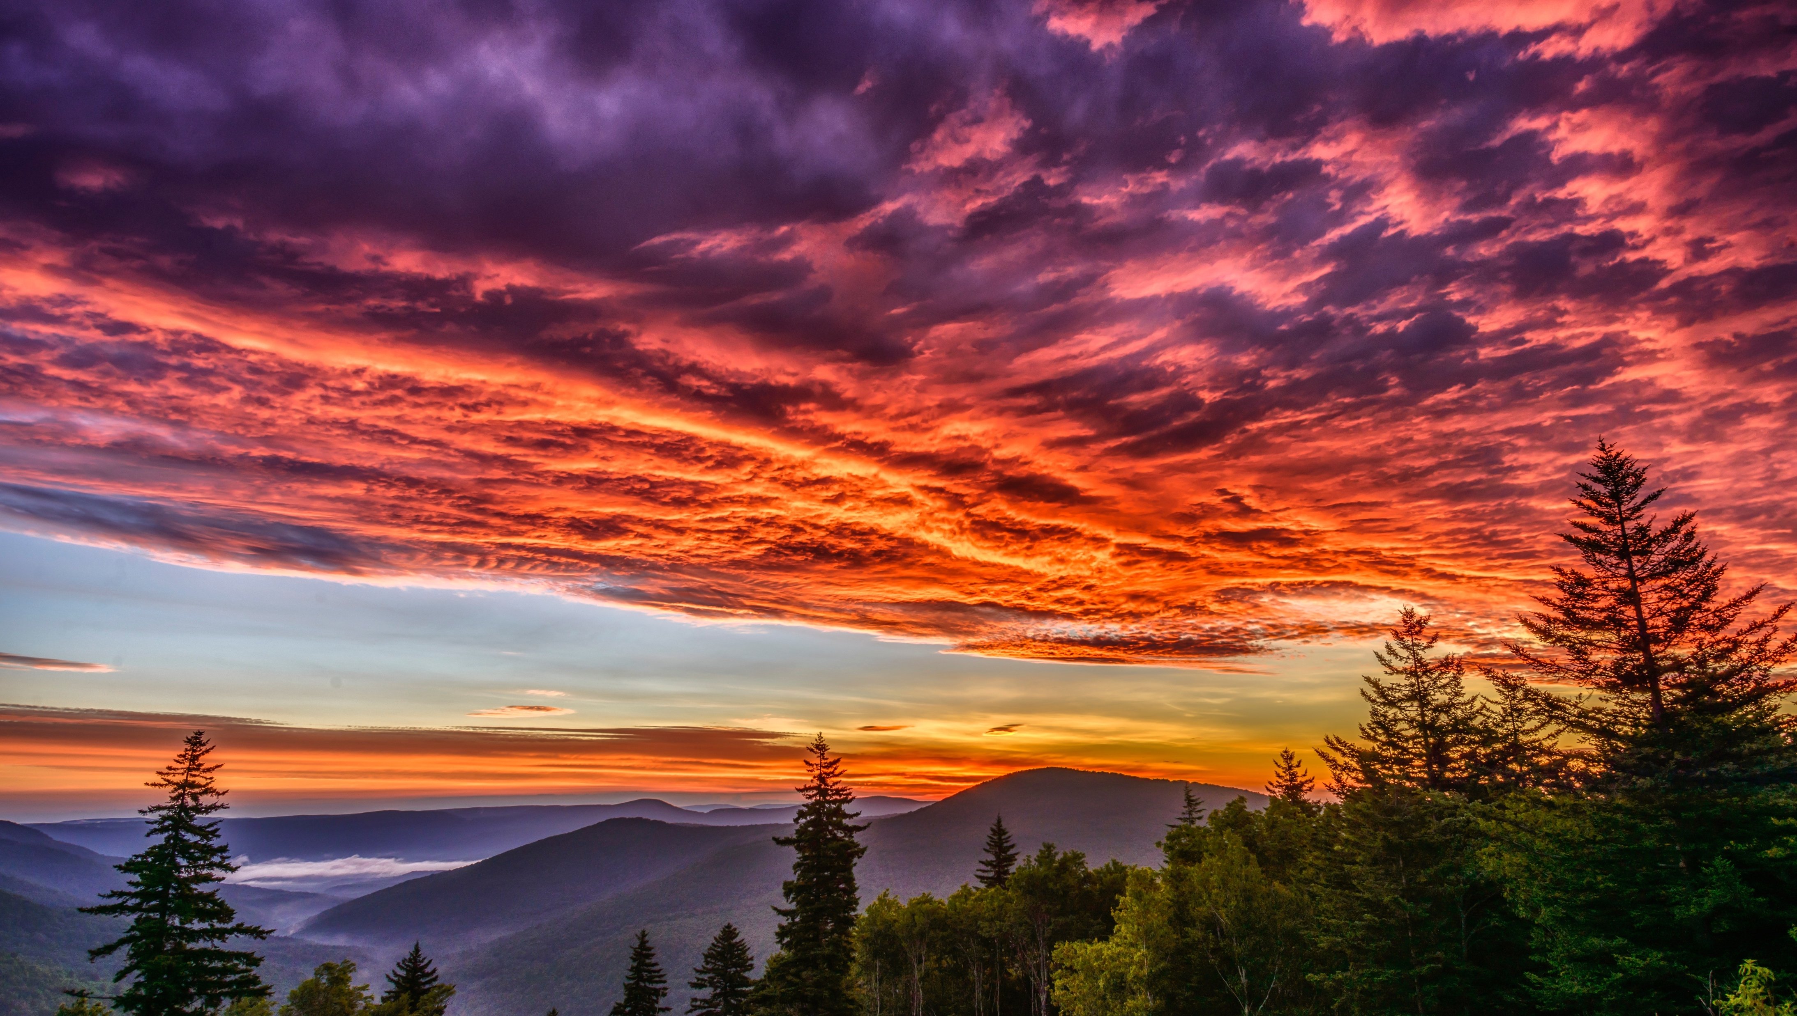
Image credits: Title slide, West Virginia State Capitol, Charleston, WV, ©Shutterstock; End slide, Williams River Valley Overlook, Black Mountain, Monongahela National Forest, West Virginia, ©Shutterstock.

