Slide 1


Smart Skills
Week 9
Timeline 2: The Napoleonic Era
Notes:
See the Smart Skills directions on the Teacher Tech Website for West Virginia: Our Beautiful Home for teaching suggestions.
Teacher notes and answers will display in this space.

Slide 2

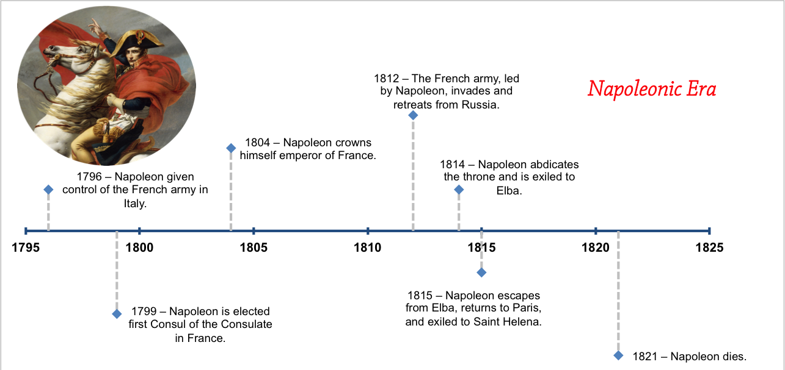
Monday
Study the graphic. Make a jot list of what you observe.
Notes:
Answers will vary. Discuss observations.
Students may observe that the graphic is a timeline and note the title. They may also note that there is a picture of a man on a horse.
TEACHER NOTES: The Napoleonic Era in European history spanned from 1799 to 1815, encompassing Napoleon Bonaparte's rise to power, his reign as Emperor of France, and the subsequent Napoleonic Wars. It is characterized by significant political, social, and military transformations across Europe, emerging from the French Revolution and culminating in Napoleon's final defeat at Waterloo. The Napoleonic Era had a significant impact on the United States, primarily through the Louisiana Purchase, disruptions to trade, and its contribution to the War of 1812. Napoleon's need for funds to finance his wars led to the sale of the Louisiana Territory to the U.S., doubling its size. Simultaneously, the ongoing conflict between France and Britain harmed American trade and led to the British impressment of American sailors, leading the U.S. to enter the War of 1812 with Great Britain.

Slide 3
TUESDAY
What years are included in this timeline?
How many years are included?
How many years was Napoleon the emperor of France?
Notes:
The timeline spans the years 1795-1825.
The timeline covers 30 years.
Napoleon was the emperor of France for 10 years.

Slide 4
WEDNESDAY
When did Napoleon crown himself Emperor of France?
When did Napoleon invade Russia?
When did Napoleon retreat from Russia?
How many years passed between Napoleon’s exile to Saint Helena and his death?
Notes:
1804
1812
1812
6 years

Slide 5
THURSDAY
The Louisiana Purchase occurred in 1803. Where would this event go on the timeline?
The United States declared war on Great Britain on June 18, 1812. What action was Napoleon leading at that time?
Notes:
At the 1803 mark, just before Napoleon crowned himself emperor.
Napoleon was leading the French invasion of Russia.

Slide 6
FRIDAY
How could this timeline be improved to add to its educational value?
Notes:
Answers will vary. Events from other countries could be added. More details could be added about Napoleon’s life, etc. The events of 1812-1815 could be a timeline of their own.

Slide 7

Image credits: Title slide, West Virginia State Capitol, Charleston, WV, ©Shutterstock; End slide, Williams River Valley Overlook, Black Mountain, Monongahela National Forest, West Virginia, ©Shutterstock.

